Slide 1
Irrigation System Using LoRa
Myungwoo Yang, Subeen Jeong, Jeongjun Lee
Chungnam National University, Purdue University

Slide 2
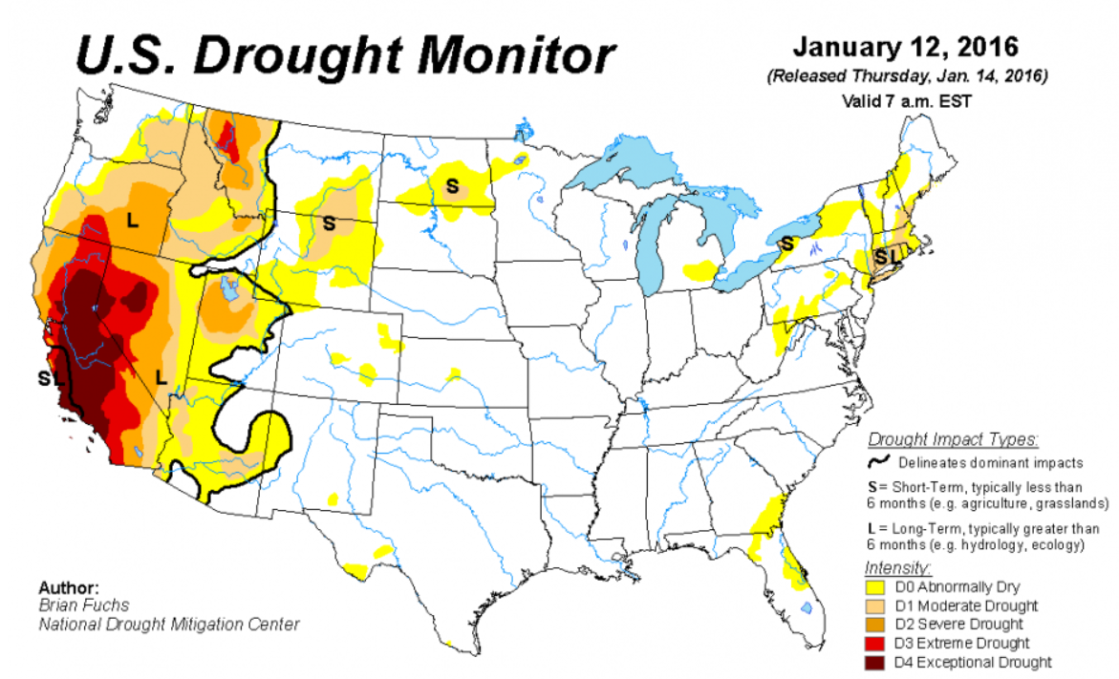
Introduction
What is problem?
Drought
There is a severe drought in the western United States.
Water usage rate
Most automatic irrigation systems use more water than is necessary.

Slide 3
Introduction
Important of method
Low Power
Most of the time, the farm is difficult to provide electronic power,
our system have to require low power.
Water usage rate
As the farm grows bigger, Reducing water usage has great economic benefits.

Slide 4
Introduction
Our method
LoRa
low-power wide-area network technology
MAD auto-irrigation algorithm
Algorithms to reduce water usage

Slide 5
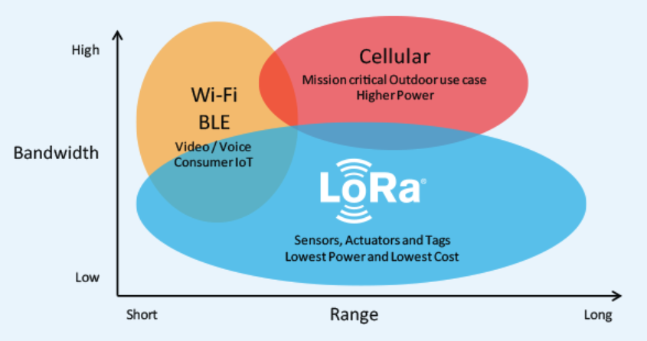
Introduction
LoRa
LoRa (Long Range) is a low-power wide-area network (LPWAN) technology

Slide 6
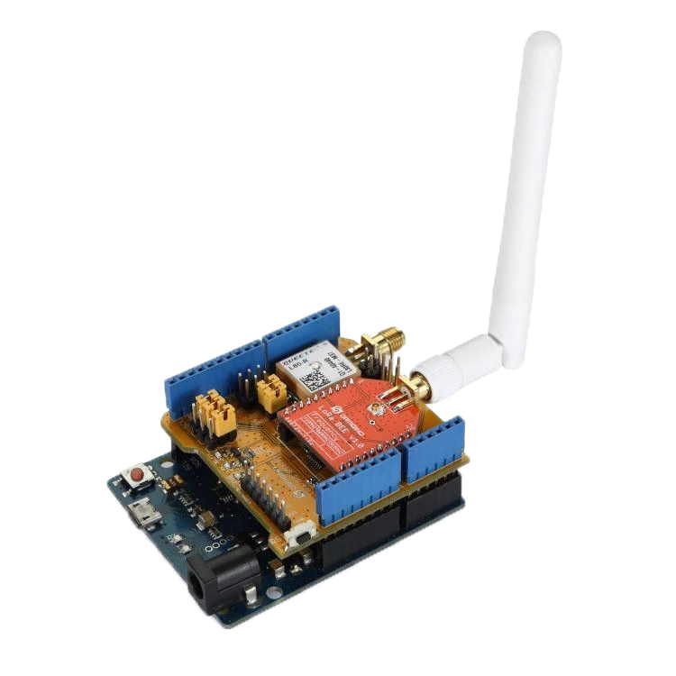

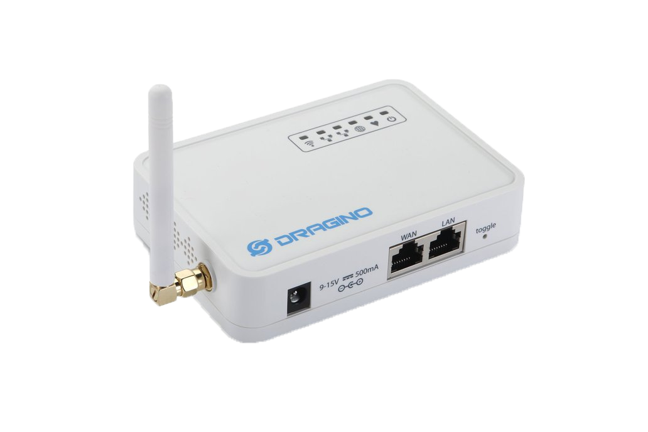
Introduction
Auto irrigation system – with LoRa
Save Data
End Node
(LoRa Shield & Bee)
LoRa Gateway
Internet
Server
Data Sensing
Humidity, soil moisture, temperature
Connect between
LoRa and Internet
Action
irrigation
Control Action

Slide 7
Introduction
MAD auto-irrigation algorithm
Management allowable depletion(MAD) specifies the maximum amount of soil water the irrigation manager chooses to allow the crop to extract from the active rooting zone between irrigations.
Only a portion of the available water holding capacity is easily used by the crop before crop water stress develops.

Slide 8
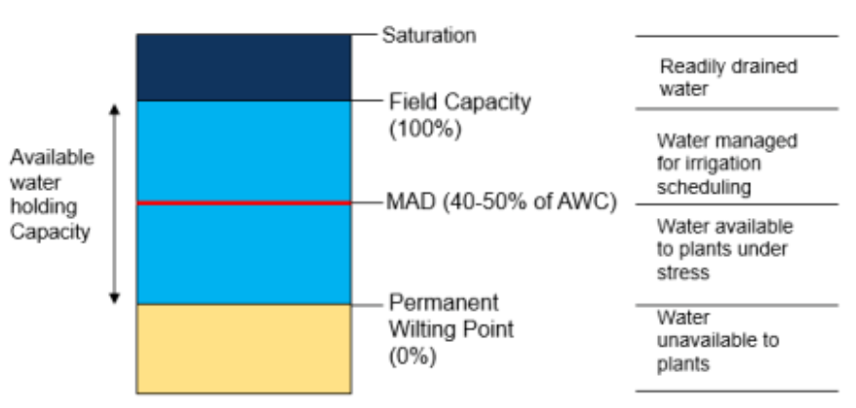
Introduction
MAD auto-irrigation algorithm

Slide 9
Introduction
MAD auto-irrigation algorithm
MAD
Input
Output
AWS
Irrigation
Condition
AWS : Amount of Water Stored in the active zone of soil

Slide 10
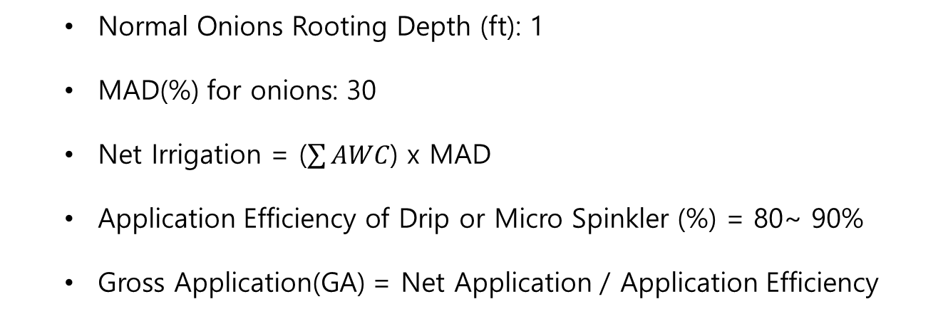
Introduction
MAD auto-irrigation algorithm
Irrigation Set Time
Normal Onions Rooting Depth (ft): 1
MAD(%) for onions: 30
Net Irrigation = ($\sum{AWC}$) x MAD
Application Efficiency of Drip or Micro Spinkler (%) = 80~ 90%
Gross Application(GA) = Net Application / Application Efficiency
Notes:
Net Irrigation : 흙이 물을 얼마나 흡수 할 수 있는지
Application Efficiency of Drip : 흙을 뿌렸을 때 흙이 얼마나 물을 흡수 하는지 나타낸다. 스프링쿨러마다 달라진다.

Slide 11
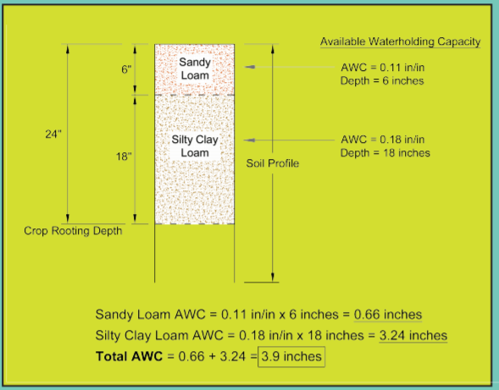
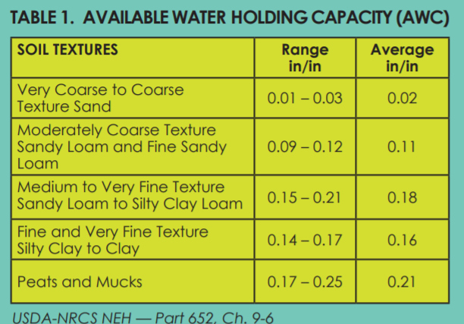
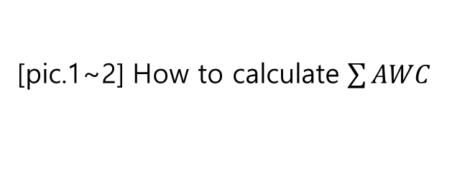
Introduction
MAD auto-irrigation algorithm
Irrigation Set Time
[pic.1~2] How to calculate $\sum{AWC}$

Slide 12
Introduction
MAD auto-irrigation algorithm
Irrigation Set Time
Where GA= Gross Application
A = Area, square feet
Q = Flow Rate per plant, gallons per hour
T = (GA x A) / 1.6 x Q
T is an irrigation set time.

Slide 13
Summary
We built an irrigation system with low power and long distance communication.
We built an irrigation system that uses less water then previous irrigation system.

Slide 14
Conclusion
Future Work:
Use Weather API
We will use weather api for prediction of rains. This is helpful for reducing water usage
Collect Data
We want to grow crops and collect data. This data will be used our paper and tell us how good our system is.

Slide 15
Thank you

